Slide 1
Next.js: Supercharging React.js for Modern Web Development
Stanislav Tudan
Notes:
Entered text
Title: Next.js: Supercharging React.js for Modern Web Development
Next.js - the powerful framework that enhances and extends React.js to meet the demands of modern web development.
I. Why We Need Something More Than React.js
React.js: A popular JavaScript library for building UIs. Its component-based architecture enables reusable components, simplifying code organization and maintenance. With a virtual DOM, it optimizes rendering performance by updating only necessary UI parts. React.js promotes declarative programming, enhancing code readability. Its vast ecosystem offers libraries and tools for efficient development of scalable and interactive web applications.
II. Limitations of React.js
1. Limited Server-Side Rendering: React.js lacks native server-side rendering (SSR), leading to slower initial page loads and potential SEO challenges.
2. SEO Difficulty: React.js-based single-page applications (SPAs) can pose difficulties for search engine indexing, affecting organic traffic and discoverability.
3. Complex Configuration: React.js requires additional setup and configuration for SSR and other advanced features, adding complexity to the development process.
4. Performance Trade-Offs: Client-side rendering (CSR) in React.js can lead to reduced performance in dynamic applications with frequent content updates.
III. Next.js
Next.js: A powerful framework enhancing React with SSR, SSG, and easy setup for modern web development.
IV. Manin advantages of the Next.js
1. Server-Side Rendering (SSR): Next.js enables server-side rendering, improving initial page load times and optimizing performance for better user experiences.
2. Static Site Generation (SSG): Next.js offers static site generation, generating static HTML files at build time for faster page loads and enhanced SEO.
3. Incremental Static Generation (ISG): Next.js supports dynamic content updates in statically generated pages, providing a balance between performance and real-time updates.
4. Streamlined Development Experience: With zero-configuration setup, Next.js simplifies project initialization and scales effortlessly, allowing developers to focus on building applications rather than complex configurations.
5. Robust Ecosystem and Community: Next.js benefits from a large and active community, providing extensive documentation, tutorials, and support, making it easier for developers to learn and leverage the framework effectively.

Slide 2
Next.js: Supercharging React.js for Modern Web Development
This presentation introduces Next.js, a powerful framework that enhances React.js to meet the demands of modern web development. It covers the limitations of React.js, the advantages of Next.js, and its features and benefits.

Slide 3
Why We Need Something More Than React.js
React.js: A popular JavaScript library for building UIs. Its component-based architecture enables reusable components, simplifying code organization and maintenance. With a virtual DOM, it optimizes rendering performance by updating only necessary UI parts. React.js promotes declarative programming, enhancing code readability. Its vast ecosystem offers libraries and tools for efficient development of scalable and interactive web applications.

Slide 4
Limitations of React.js
Limited Server-Side Rendering: React.js lacks native server-side rendering (SSR), leading to slower initial page loads and potential SEO challenges.
SEO Difficulty: React.js-based single-page applications (SPAs) can pose difficulties for search engine indexing, affecting organic traffic and discoverability.
Complex Configuration: React.js requires additional setup and configuration for SSR and other advanced features, adding complexity to the development process.
Performance Trade-Offs: Client-side rendering (CSR) in React.js can lead to reduced performance in dynamic applications with frequent content updates.

Slide 5


Slide 6
Next.js Overview
Next.js is a powerful framework built on top of React.js. It enhances React by providing server-side rendering (SSR) and hybrid rendering capabilities, improving performance and SEO. Next.js simplifies development with zero-configuration setup and offers features like static site generation (SSG) and incremental static generation (ISG) for lightning-fast page loads. It seamlessly integrates with other frameworks and libraries, making it a versatile choice for modern web development.

Slide 7
Advantages of Next.js
Server-Side Rendering (SSR): Next.js enables server-side rendering, improving initial page load times and optimizing performance for better user experiences.
Static Site Generation (SSG): Next.js offers static site generation, generating static HTML files at build time for faster page loads and enhanced SEO.
Incremental Static Generation (ISG): Next.js supports dynamic content updates in statically generated pages, providing a balance between performance and real-time updates.

Slide 8
Streamlined Development Experience: With zero-configuration setup, Next.js simplifies project initialization and scales effortlessly, allowing developers to focus on building applications rather than complex configurations
Robust Ecosystem and Community: Next.js benefits from a large and active community, providing extensive documentation, tutorials, and support, making it easier for developers to learn and leverage the framework effectively.
One of the best things about Next.js is its rendering options. You are not tied to CSR, SSR, or SSG and can choose which pages you want to render on the server side, client-side or which ones you want to be entirely static.

Slide 9
In summary, the primary benefits of Next.js are:
Improved development process = cost and time benefit to our clients
Improved performance = faster applications
Improved SEO = more indexable, SEO friendly applications

Slide 10

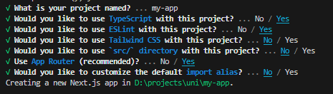
Create Your First App

Slide 11
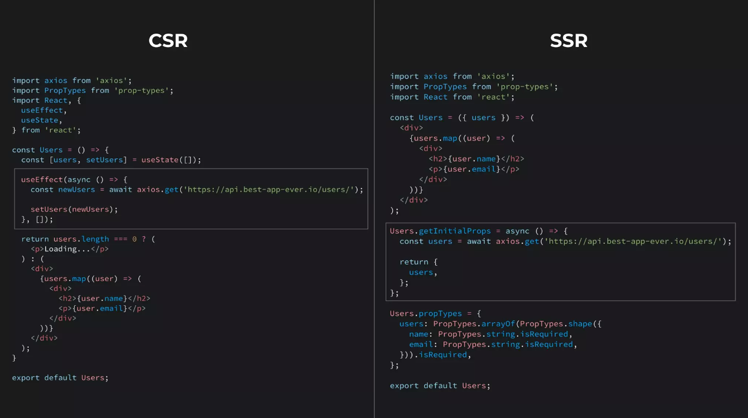

Slide 12

Code splitting

Slide 13

Code splitting
The user doesn't need all of your 19 MB bundle.js in order to see your 'about' page

Slide 14
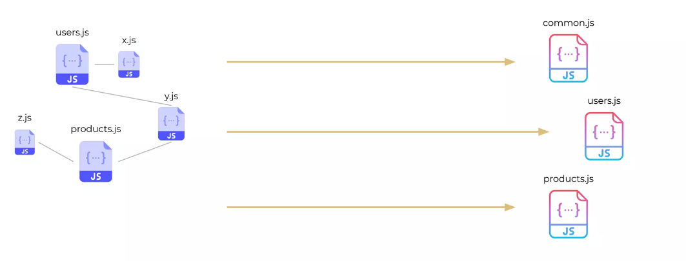
Code splitting
It breaks javascript bundle into pieces and loads only when needed
Next.js does automatic code splitting and it is based on the pages in your app

Slide 15
Summary
To summarize, Next.js extends the capabilities of React.js, addressing its limitations and offering significant advantages for modern web development. With features like server-side rendering (SSR), static site generation (SSG), and incremental static generation (ISG), Next.js greatly enhances performance, improves SEO, and provides a streamlined development experience. Its versatility and scalability make it suitable for projects of any scale, while its extensive ecosystem and community support ensure developers have the resources they need. By combining the power of React.js with Next.js, developers can create high-performing, interactive web applications efficiently, taking their projects to the next level.

Slide 16
Thank you.😄

